Slide 1
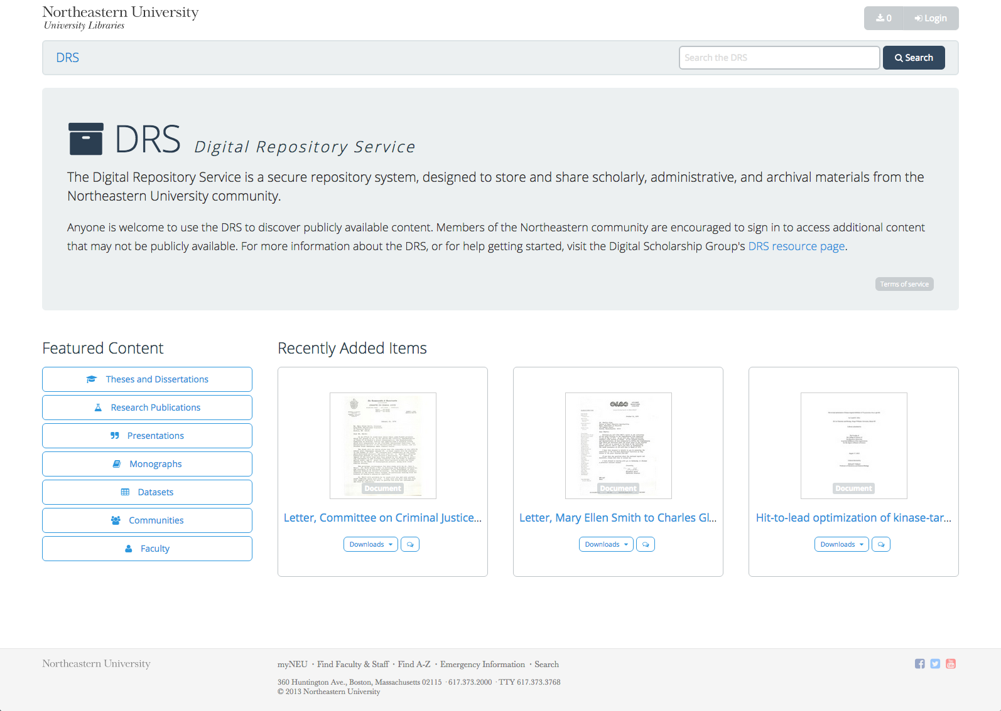

Sarah Sweeney
Digital Repository Manager
Northeastern University Library
repository.library.northeastern.edu
Notes:
Promotional Slide

Slide 2
History
Mid – late 2000’s: Various proprietary repos
2010: Beta Fedora Repo: repository.neu.edu
Summer 2013: Development begins on a new Fedora repo with a Hydra interface
Fall 2014: Soft launch to faculty and staff
January 2014: Informal usability testing
Spring 2015: Full launch to internal and external users

Slide 3
DRS Goals and User Population
Why Use the DRS?
To reliably store and preserve work in one secure location.
To easily share valued work with colleagues.
To efficiently discover scholarly content and projects produced at Northeastern.
Who is it for?
Searching and browsing: anyone
Depositing: faculty and some staff

Slide 4
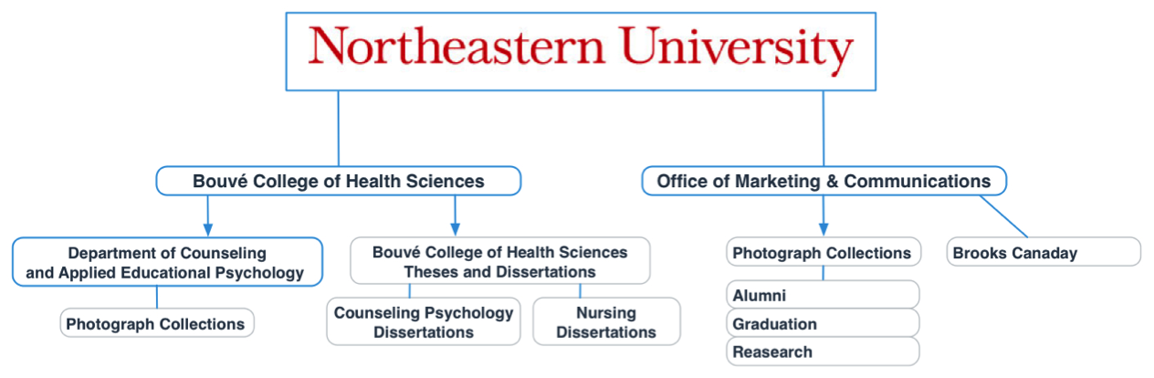
DRS Structure
The DRS is organized hierarchically according to the NU structure:

Slide 5
DRS Structure
The DRS contains a few different digital object types:
Communities
Regular Collections
Smart Collections
Files
Faculty

Slide 6
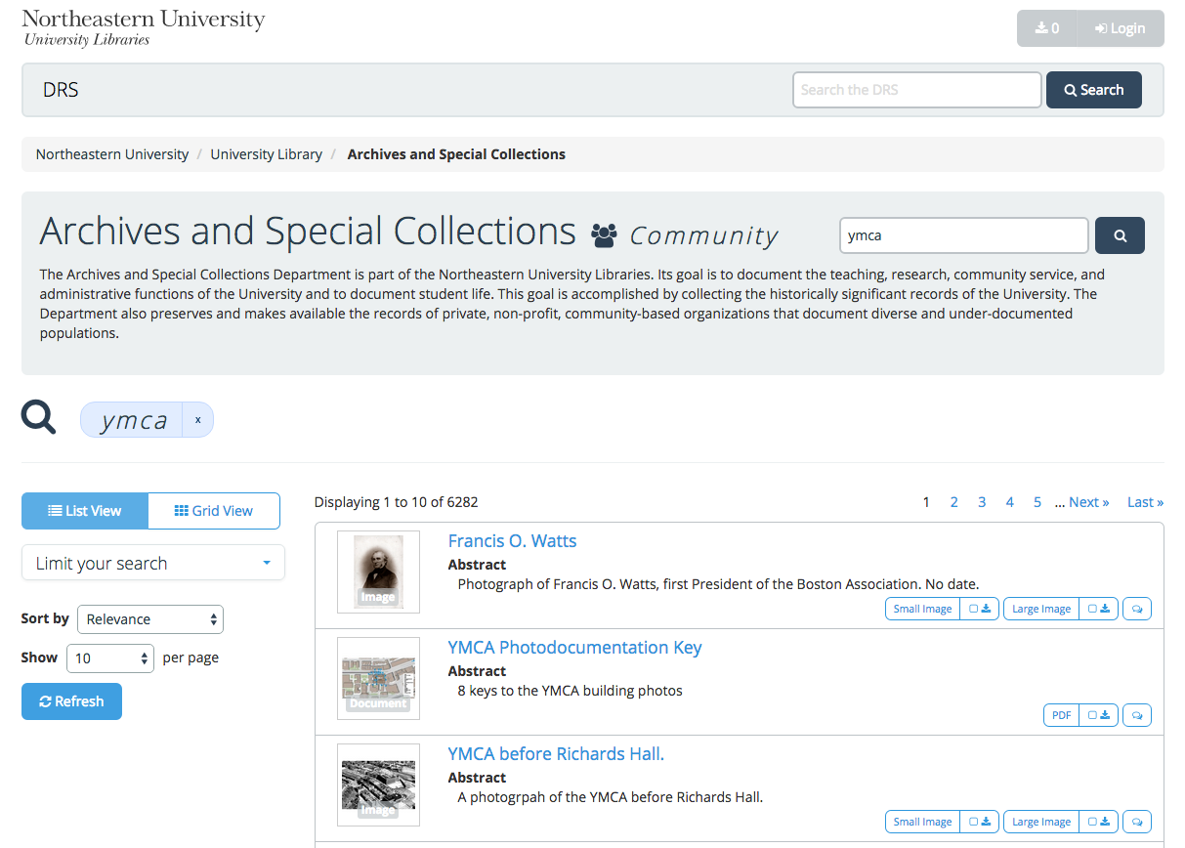
DRS Features/Layout
Link to library homepage
Download Queue and User Area
Link to DRS homepage
Breadcrumbs
Persistent Full DRS Search Box
Scoped search for communities and collections
Multiple views
Facets
Direct download options & Download Queue
Result customizations
Report-a-problem Button
Not pictured: Sets

Slide 7
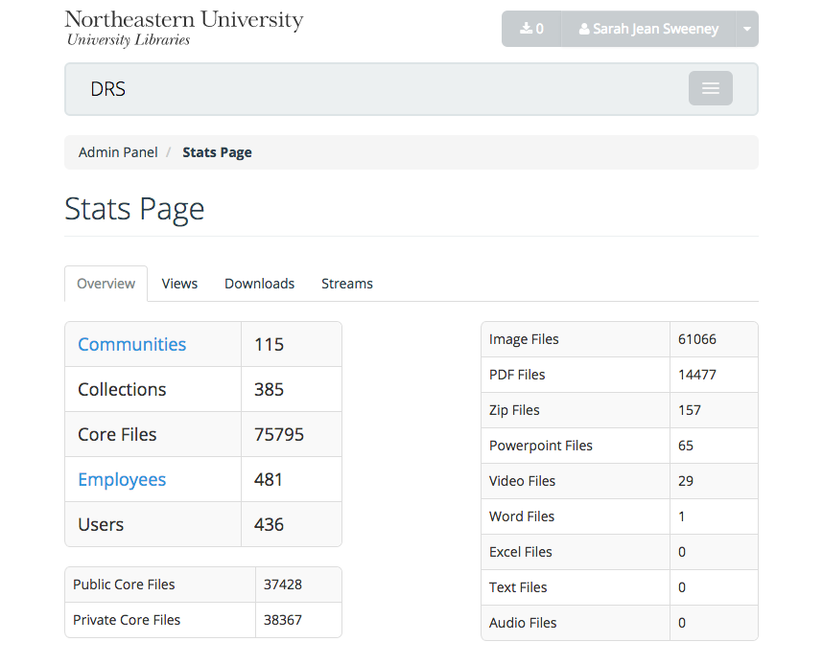
DRS Usage Analysis
Impressions
(since October 2014)
Metadata Page Views:
136,550
File Downloads
24,808
Media Streams
33
*
*A core file is the basic metadata page for a file. When we count views, we are counting views of the core file.

Slide 8
Usability Goals and Tasks
Site Improvement Goals
Research Questions/Tasks
Did the improvements implemented after our last round of usability testing work?
How can we improve access to existing content, or remove barriers to discovery?
Responsiveness?
Searching/discovery success
Easy of finding content produced by departments
Is the difference between Sets and the Download Queue clear?

Slide 9
DRS
Resources
Contact
https://repository.library.northeastern.edu
http://dsg.neu.edu/resources/drs
sj.sweeney@neu.edu
Sarah Sweeney
Digital Repository Manager
Northeastern University Library
repository.library.northeastern.edu
Notes:
Promotional Slide

